Slide 1
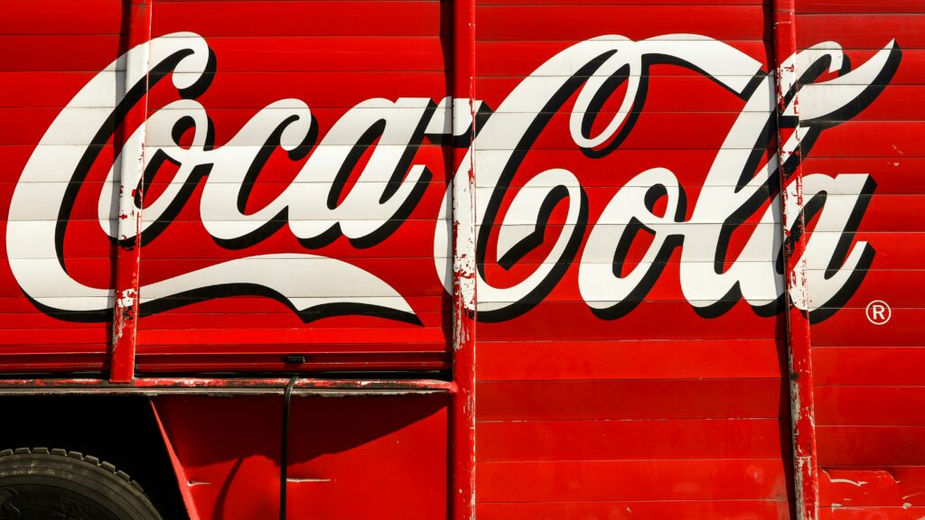
Valuation Report: The Coca-Cola Company (NYSE: KO)

Slide 2
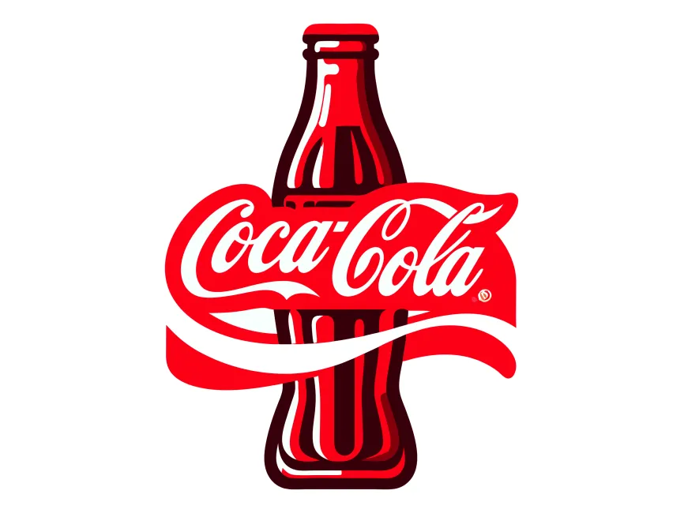
Table of Content
Company Overview
Industry Overview
Comparable Company Analysis (CCA)
DCF Valuation
Qualitative inputs for DCF Model (Assumption)
Interpretation & Conclusion
Appendix
Historical Revenue Statement
Ratios
Disclaimer: This valuation report is prepared solely for academic and learning purposes. All analysis, assumptions, and conclusions are based on publicly available information and do not constitute investment advice.

Slide 3
Company Overview
The Coca-Cola Company – NYSE ( KO US Equity )
Sector
Consumer Staples
Industry
Soft Drinks & Non-alcoholic Beverages
Website
www.coca-colacompany.com
Business - The Coca-Cola Company, a beverage company, manufactures and sells various non-alcoholic beverages in the United States and internationally. The company provides sparkling soft drinks and Flavors; water, sports, coffee, and tea; juice, value-added dairy, and plant-based beverages; and other beverages. It also offers beverage concentrates and syrups, as well as fountain syrups to fountain retailers comprising restaurants and convenience stores. It operates through a network of independent bottling partners, distributors, wholesalers, and retailers, as well as through bottling and distribution operators.
Products
Concentrates, syrups, fountain syrups, Company Trademark Beverages, Trademark Coca-Cola Beverages

Slide 4
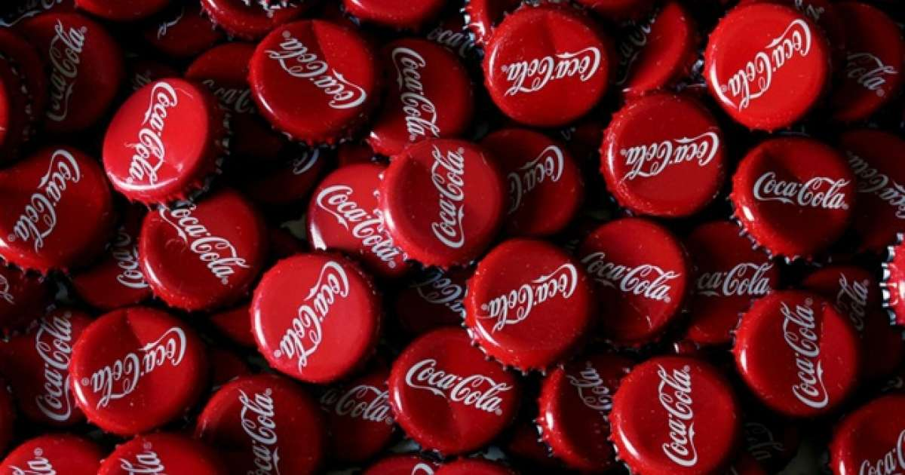
Company Overview
Operations or revenue recognition
Company operates in two lines of business: concentrate operations and finished product operations.
Our concentrate operations typically generate net operating revenues by selling beverage concentrates, sometimes referred to as “beverage bases,” syrups, including fountain syrups, and certain finished beverages to authorized bottling operations (to which we typically refer as our “bottlers” or our “bottling partners”).
Our finished product operations generate net operating revenues by selling sparkling soft drinks and a variety of other finished beverages to retailers, or to distributors and wholesalers who in turn sell the beverages to retailers. Generally, finished product operations generate higher net operating revenues but lower gross profit margins than concentrate operations. These operations consist primarily of our consolidated bottling and distribution operations, which are included in our Bottling Investments operating segment.

Slide 5
Industry Overview
Soft Drinks & Non-alcoholic Beverages
Emerging Trends in the Non-Alcoholic RTD Beverages Industry
The global non-alcoholic beverages market size was estimated at USD 1,223.93 billion in 2023 and is projected to reach USD 1,997.25 billion by 2030, growing at a CAGR of 7.4% from 2024 to 2030. With the growing acceptance of the no-alcohol and low-alcohol categories by consumers, manufacturers in the market are catering to the new trends and have been innovating existing product portfolios, which is likely to bode well for future growth.
Industry Overview – Key Growth Factors
Growing Need for Non-Alcoholic Drinks Consumers are shifting toward healthier, aspirational, and functional hydration choices, especially products offering relaxation, mood enhancement, and organic ingredients.
Health-Driven Choices Demand is rising for beverages with functional benefits—like vitamins, antioxidants, and natural hydration—while consumers cut down on sugar, calories, and artificial additives. with 61% of CSD users aged 35–54 saying added vitamins/minerals would make soft drinks a healthier choice.
Personalization Trends in RTD Beverages The emergence of AI-powered platforms that offer subscription services and customized blends is an intriguing development for 2024. DIY beverage kits including soda makers, kombucha brewing kits, and infused tea, water, and mocktails that may be made at home. These AI systems may generate distinctive flavour profiles by analysing user data such as dietary limitations, taste preferences, and health objectives.

Slide 6
Comparable Company Analysis (CCA)

Slide 7
DCF Valuation

Slide 8
DCF Valuation

Slide 9
Qualitative inputs for DCF Model (Assumptions)
Revenue
Coca-Cola operates through concentrate sales and finished products, and revenue growth from 2021–2024 has slowed, reflecting a transition into steady, mature-market growth rather than high expansion.
Growth is constrained by intense competition from global peers and strong regional/local beverage players, limiting additional pricing power and market-share gains.
FX headwinds (~5%) reduced reported revenue despite stable underlying demand, and management expects similar currency pressure for FY25 due to a strong U.S. dollar. Used FX derivatives hedging strategies to mitigate volatility on reported revenues.
Pricing, product mix, and geographic mix contributed an 11% boost to FY24 revenue, showing company’s ability to offset currency pressure and weaker low-margin markets and strengthen the beverage revenue with low/no-calorie and functional products to capture shifting demand.
Strong revenue contribution from North America aligns with increased CAPEX in the region, supporting long-term category strength and operational efficiency.
Company has ability of acquisition and support for growth in long run evaluate acquisitions of brands or bottling operations, particularly in underperforming markets, to expand presence and improve performance ( Example - Costa Coffee, Fairlife, BodyArmor).
COGS
Raw material inflation — especially water, sugar, sweeteners, and packaging materials — continues to put pressure on Coca-Cola’s gross margins.
Increased use of recycled packaging content supports long-term cost reduction efforts, though initial transition costs remain elevated and Climate-related risks pose a threat: water scarcity and extreme weather may increase production costs over time.
Packaging initiatives such as Extended Producer Responsibility (EPR) and Deposit Return Schemes (DRS) can reduce packaging waste and eventually lower raw-material requirements, improving efficiency.

Slide 10
Qualitative inputs for DCF Model (Assumptions)
SG&A
SG&A has improved over the past decade due to productivity initiatives, but recent trends show rising expenses driven by higher advertising, promotional spending, and employee-related costs to increase revenue
Increased competitive pressure requires continued investment in brand visibility and market activation, which will keep SG&A slightly elevated in the long term.
D&A + Capex Assumptions
D&A has gradually declined since 2020, . However increasing spending on bottling Bottling Investments, indicates D&A slightly increase in future.
Coca-Cola’s capital allocation priorities remain disciplined: investing in core operations, maintaining dividend growth, and offsetting share dilution through buybacks. Company expects FY25 Capex to be approximately $2.2 billion FY25
Working Capital
Credit risk remains low due to company diversified global customer base, but AR has increased in recent years. The company uses factoring programs to sell receivables to financial institutions, improving working capital and reducing AR balances. Company sold $21.9B of receivables in 2024 and $17.7B in 2023.

Slide 11
Interpretation & Conclusion
Interpretation Company comparable analysis (CCA)
Coca cola is trading in premium due to its strong brand name and leader in their industry. due to their stable growth and strong profit margin, investors are viewing stock in optimistic that it will perform better in long run.
Peer-implied valuation (EV 228B–290B) is below Coca-Cola’s actual EV of 340B, indicating slight overvaluation relative to competitors.
Overall, CCA suggests company market price is expensive compared to peers on operational valuation metrics but fairly valued on earnings stability.
DCF interpretation
The model implies a fair value of $53.70/share versus a market price near $71.16, suggesting overvaluation. The downside mainly comes from moderate long-term growth assumptions, which limit terminal value.
DCF indicates Coca-Cola’s market price reflects higher future expectations than what fundamentals currently justify
Market pricing suggests investors are willing to pay a premium for brand value and stability not necessarily growth.
Conclusion Coca cola is fundamentally strong but moderately overvalued compared to its fair value, with valuation driven by sentiment, brand value and future performance rather than current growth.

Slide 12
Appendix – Historical revenue information

Slide 13
Appendix – Ratios

